Slide 1
2021-2027 EU4Health Programme
Health and Digital Executive Agency (HaDEA)

Slide 2
EU4Health Work Programme 2024 Action Grants (HERA) (EU4H-2024-PJ-01)
Administrative aspects of action grants
Giuseppe Simone
Programme Manager
Health and Digital Executive Agency (HaDEA)
Brussels, 29 May 2024

Slide 3
Who we are

Slide 4
EC vs EAs
European
Commission
Executive
agencies
DGs (DG RTD, etc…)
EAs (CINEA, HaDEA, etc…)
Definition of policies
Drafting of Work Programme
Implementation of calls for proposals
Management of funded projects

Slide 5
Our Agency
The European Health and Digital Executive Agency (HaDEA) implements European programmes and initiatives on behalf of the European Commission, by managing projects that are related to health, digital, food, industry and space.
Health
Food
Industry
Space
Digital

Slide 6
Our parent DGs
SANTE
Health & Food Safety
RTD
Research & Innovation
GROW
Internal Market, Industry,
Entrepreneurship
and SMEs
DEFIS
Defence Industry & Space
HERA
European Health Emergency Preparedness and Response Authority
CNECT
Communications Networks,
Content & Technology
HaDEA

Slide 7
What we do

Slide 8
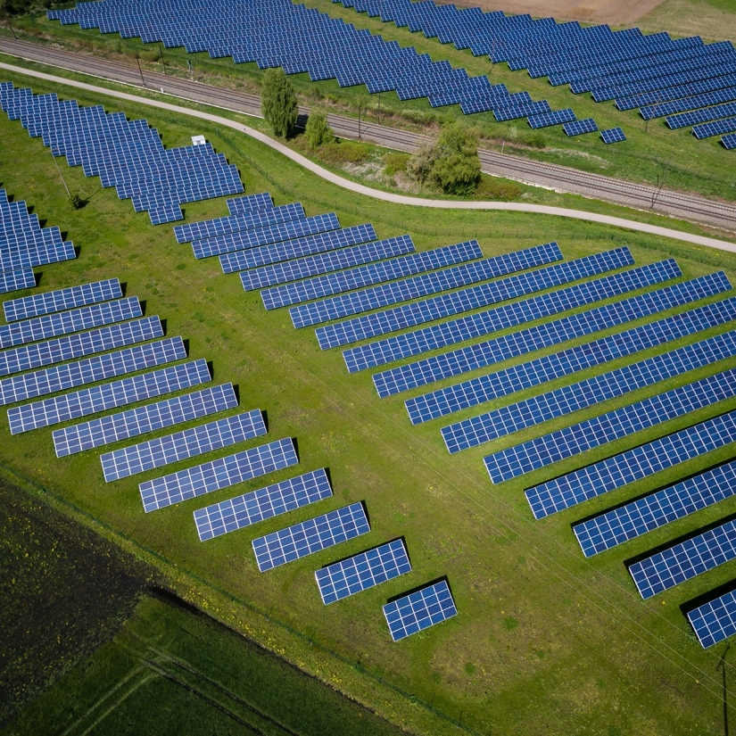
The programmes we manage
Health
Food
Digital
Industry
Space
EU4Health
Horizon Europe – Health
Single Market Programme (SMP): Food Safety
Horizon Europe – Digital
Connecting Europe Facility – Digital
Digital Europe Programme
Horizon Europe
– Industry
Horizon Europe – Space

Slide 9
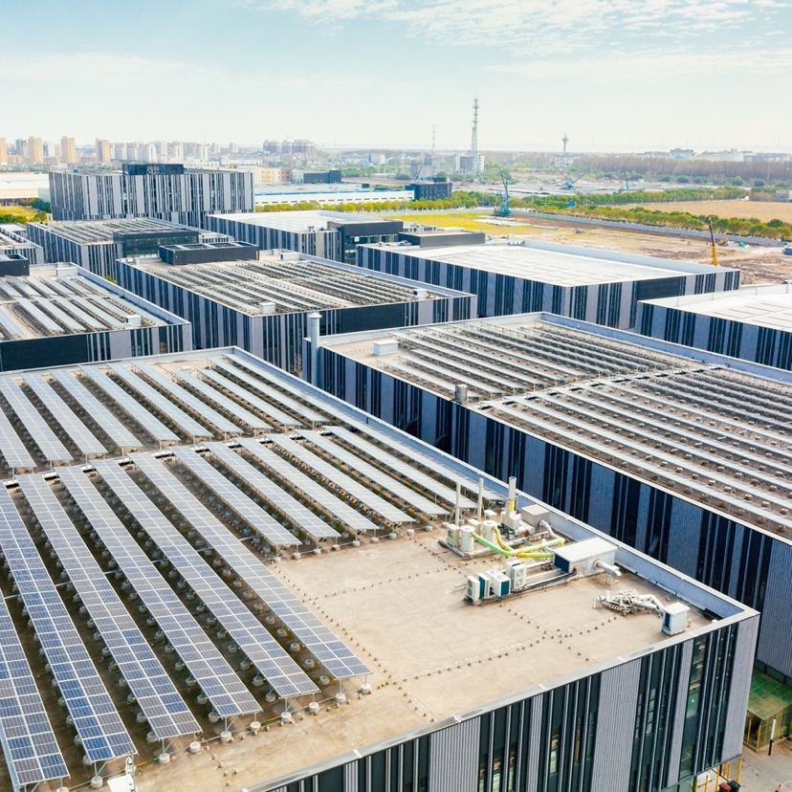
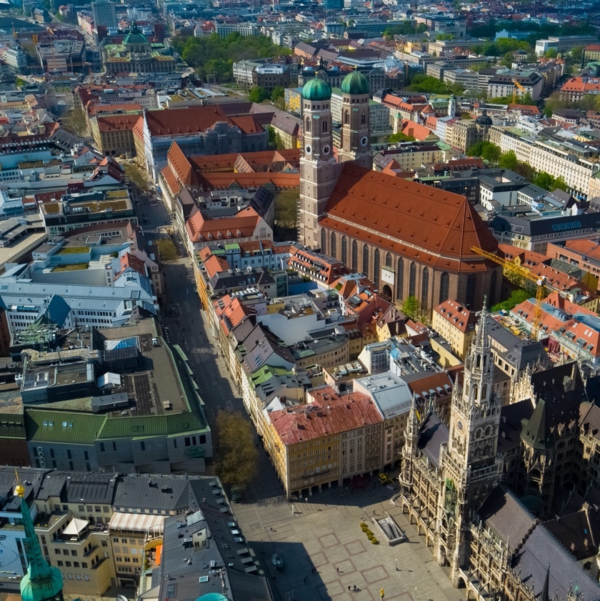
HaDEA’s beneficiaries
Industry
Research institutes
Academia
International
organisations
National, regional and local authorities
Representatives of civil society
NGOs

Slide 10
Projects funded and services purchased by HaDEA
Research & innovation
Knowledge-sharing
Training, networking,
events
Software design
Manufacturing

Slide 11
Project management lifecycles
Procurement
Preparation of tender specifications
Publication
of calls*
Submission
of tenders
Evaluation
of tenders
Opinion from the advisory committee on procurement and contracts (ACPC)**
Award decision, signature and management of the ensuing contracts
Grants
Call for proposals
Proposal submissions
Evaluation & selection
Signature of grant agreements
Project monitoring
Dissemination of final results
General overview of the processes: video here
* for open calls: services requested under existing framework contracts
** for open calls only

Slide 12
How to participate

Slide 13
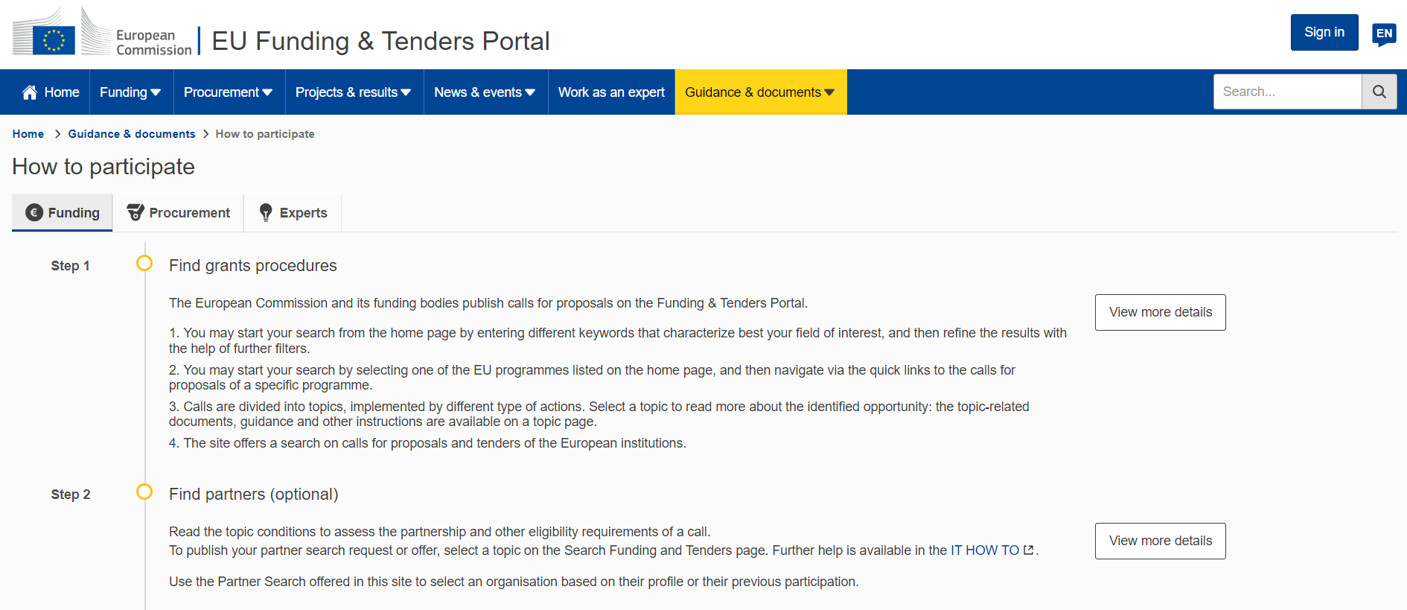
How to participate - Funding | EU Funding & Tenders Portal (europa.eu)

Slide 14
How to participate - Funding | EU Funding & Tenders Portal (europa.eu)

Slide 15
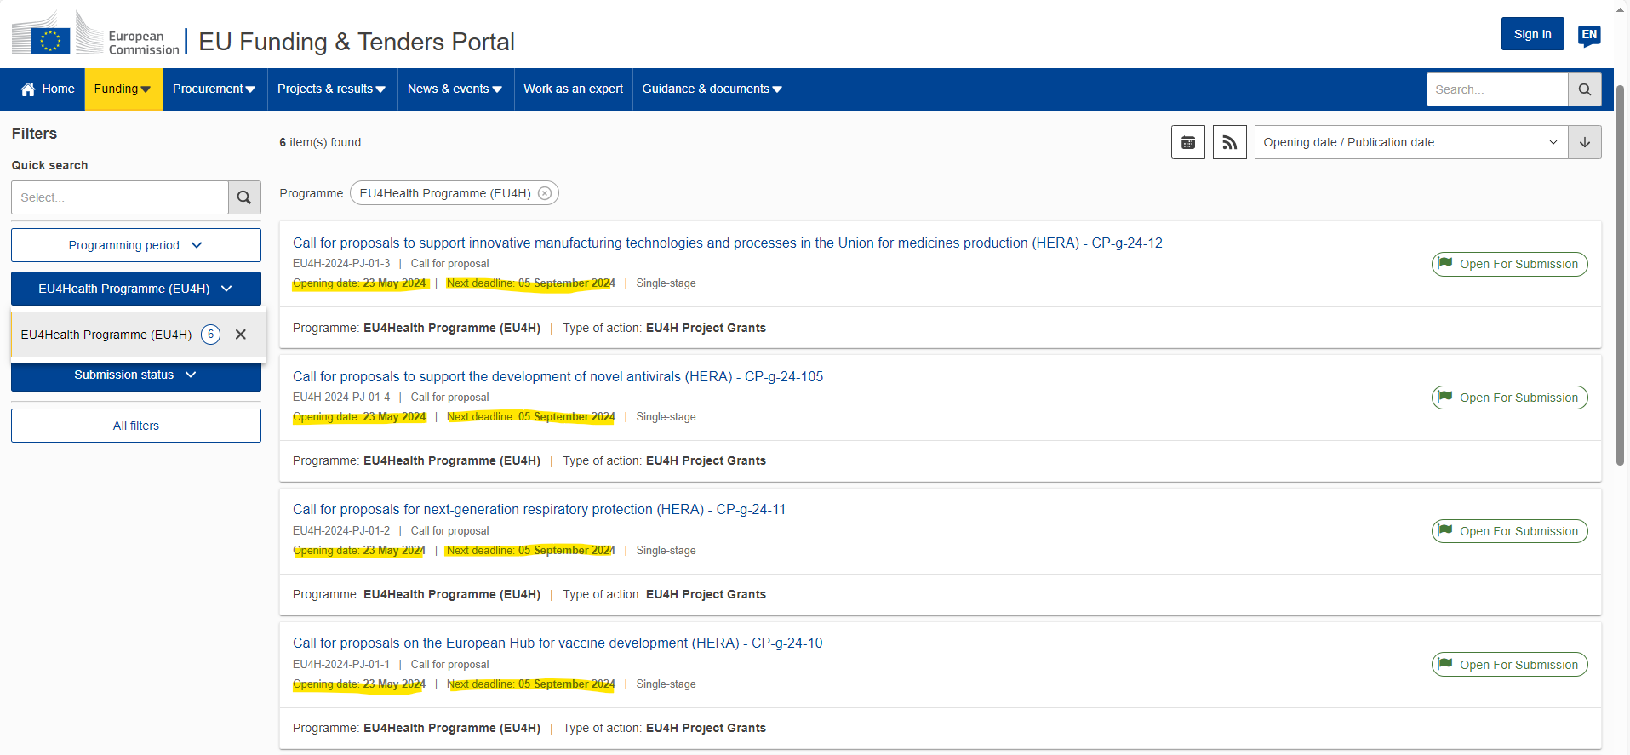
Grant procedures
Calls for proposals | EU Funding & Tenders Portal (europa.eu)

Slide 16
Timetable and deadlines
Call opening: | 23 May 2024
Deadline for submission: | 05 September 2024 – 17:00:00 CET (Brussels)
Evaluation (indicative): | September-October 2024
Information on evaluation results (indicative): | October-November 2024
GA signature: | 07 June 2025

Slide 17
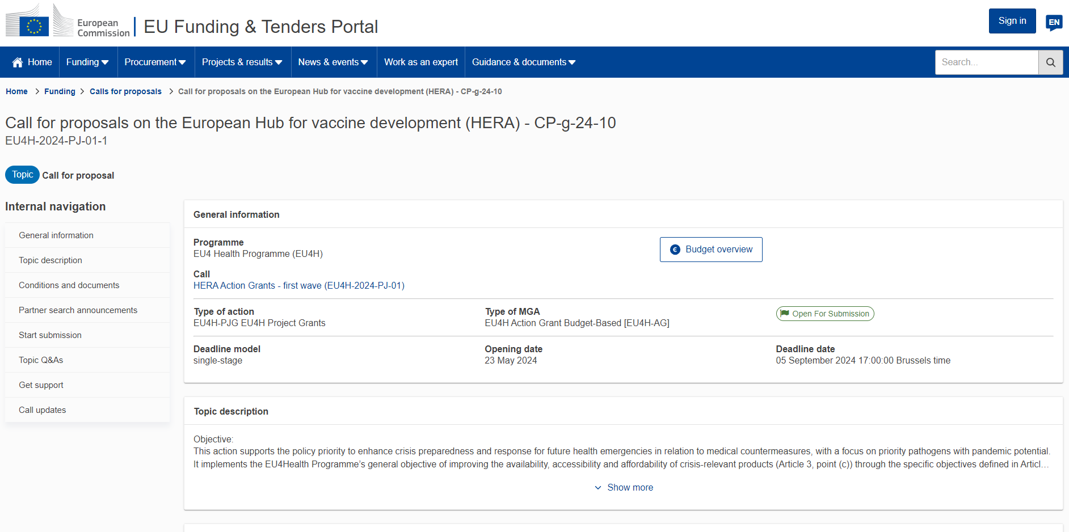

Slide 18
Topic conditions and documents
1. Admissibility conditions: described in section 5 of the call document
Proposal page limits and layout: described in Part B of the Application Form available in the Submission System
2. Eligible countries: described in section 6 of of the call document
3. Other eligibility conditions: described in section 6 of the call document
4. Financial and operational capacity and exclusion: described in section 7 of the call document
5. Evaluation and award:
Award criteria, scoring and thresholds: described in section 9 of the call document
Submission and evaluation processes: described section 8 of the call document and the Online Manual
Indicative timeline for evaluation and grant agreement: described in section 4 of the call document
6. Legal and financial set-up of the grants: described in section 10 of the call document
Call documents:
Call document
Standard application form ([ToA])
Detailed budget table ([ToA])
EU4Health Programme General MGA v1.1
EU4Health Work Programme 2024
EU4Health Regulation 2021/522
EU Financial Regulation 2018/1046

Slide 19
Start submission

Slide 20
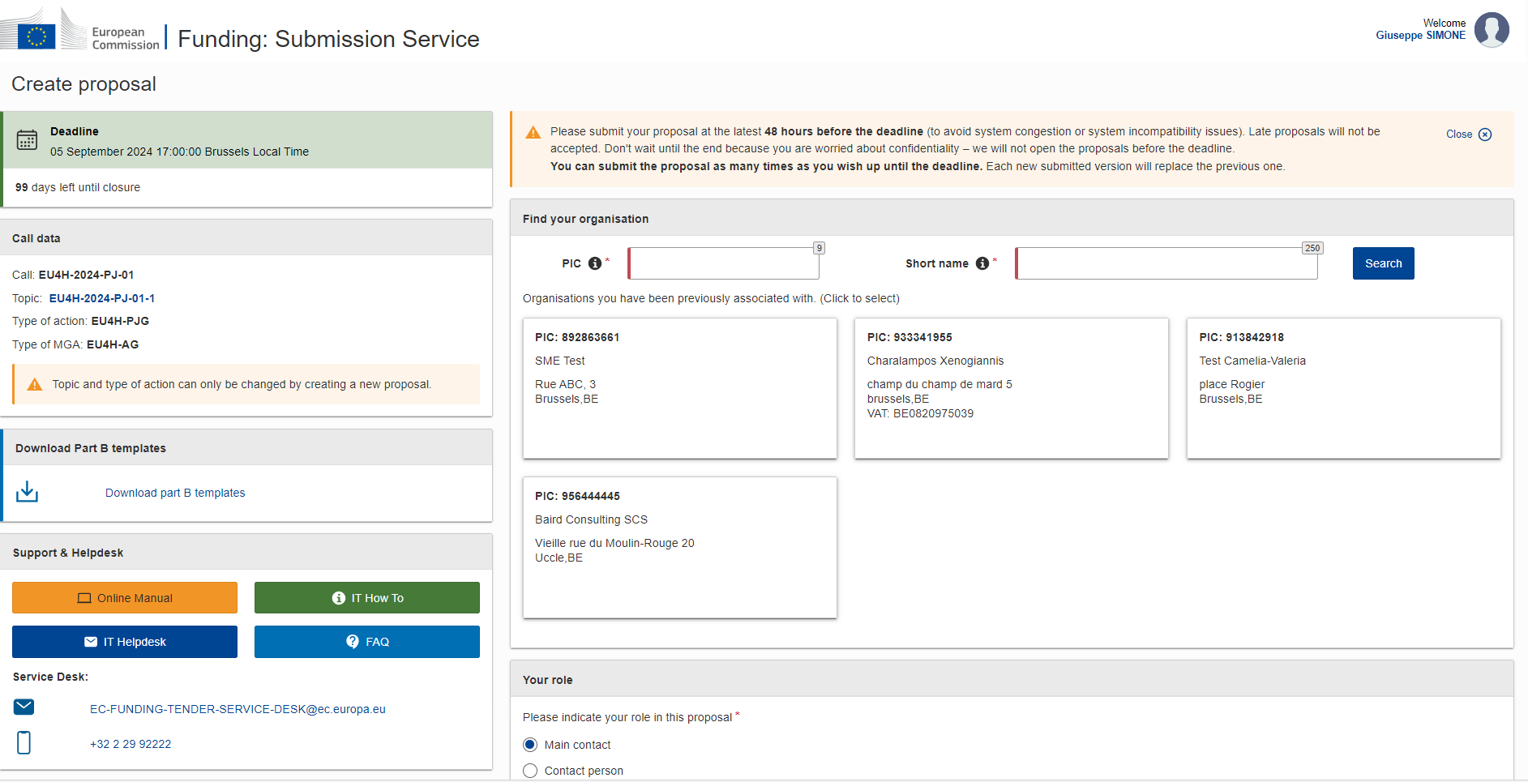

Slide 21
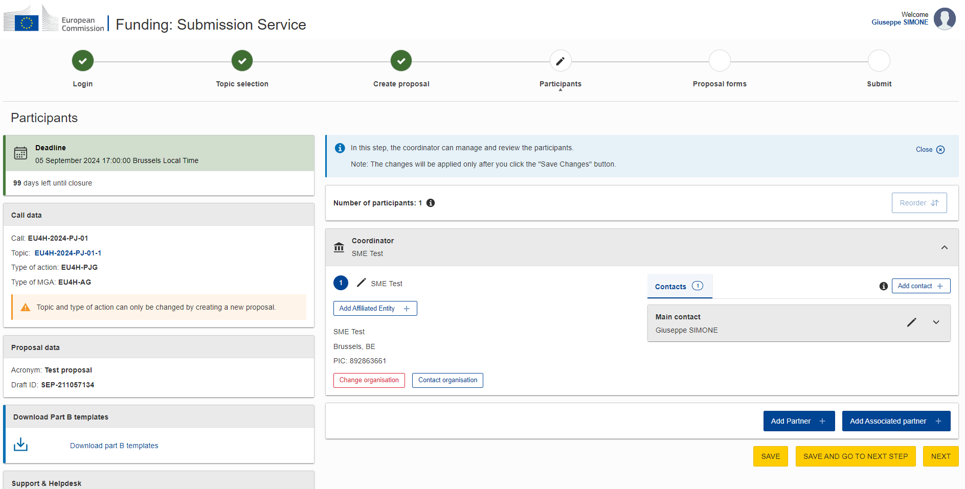

Slide 22
Structure of the proposal

Slide 23
Structure
Part A
Part B
Annexes
Administrative forms
Technical / Narrative
Detailed Budget
Detailed budget
Overview budget
CVs
List of previous projects
…..

Slide 24
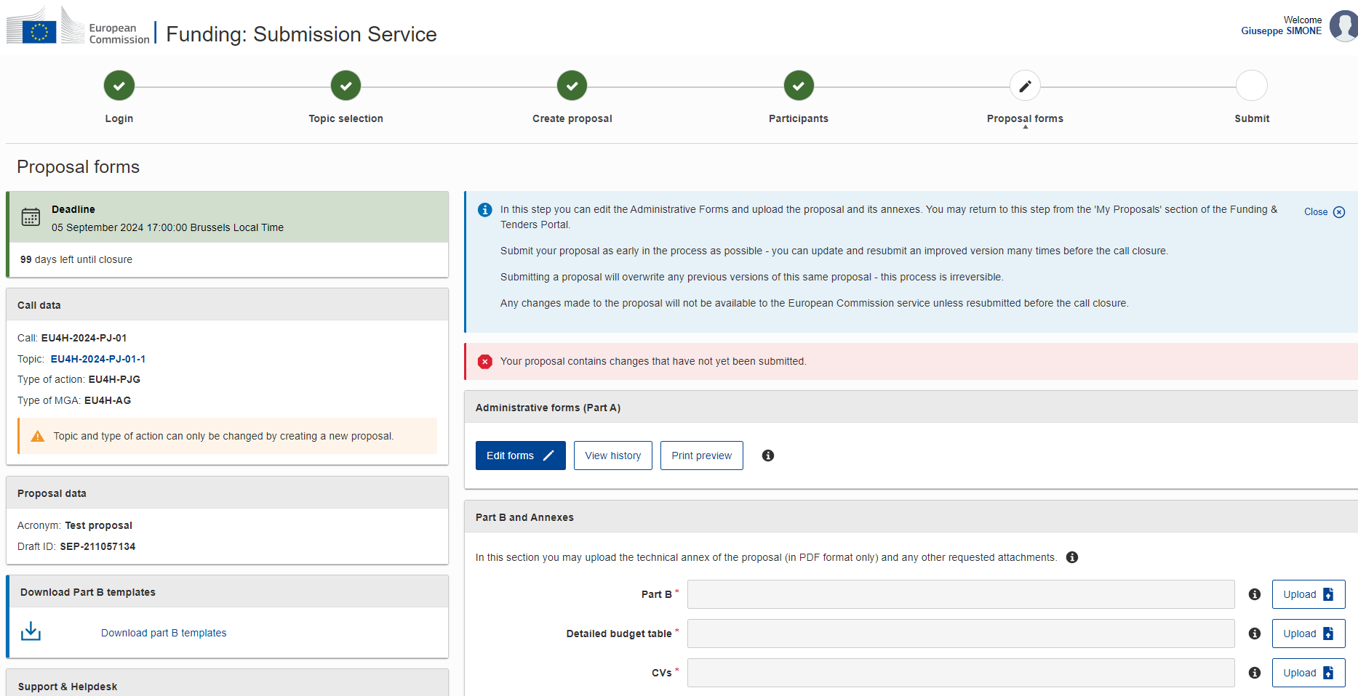
Part A
Administrative Forms

Slide 25
Part A – Administrative Forms (on-line)
Section 1 – General information
Title, duration, abstract, keywords
Declarations (tickboxes)
Section 2 – Participants
Organisation data and contact details of all the participants - roles
Section 3 – Budget (overview)
Ensure it is in line with detailed budget
Section 4 – Other questions
clinical studies / trials / investigations and GHG emissions
Save
Validate and correct red « errors » and yellow « warning »

Slide 26
Part B – Technical description (I)
RELEVANCE
Background and general objectives
Needs analysis and specific objectives
Complementarity with other actions and innovation — European added value
QUALITY
Concept and methodology
Consortium set-up
Project teams, staff and experts
Consortium management and decision-making
Project management, quality assurance and monitoring and evaluation strategy
Cost effectiveness and financial management
Risk management

Slide 27
Part B – Technical description (II)
IMPACT
Impact and ambition
Communication, dissemination and visibility
Sustainability and continuation
WORK PLAN, WORK PACKAGES, TIMING AND SUBCONTRACTING
Work plan
Work packages and activities
Timetable
Subcontracting
OTHER
Ethics
Security

Slide 28
Part B – Technical description (III)
DECLARATIONS
Higher funding rate
Double funding
Financial support to third parties (NOT APPLICABLE TO THIS CALL)
ANNEXES
Detailed budget table (annex 1 to Part B) — mandatory
CVs (annex 2 to Part B) — mandatory, if required in the Call document
List of previous projects (annex 4 to Part B) — mandatory, if required in the Call document

Slide 29
Recommended Structure of a proposal
Technical WP (WP 5)
Coordination (WP 1)
Dissemination (WP 2)
Technical WP (WP 6)
…
Technical WP (WP xx)
Evaluation (WP 3)
Sustainability (WP 4)

Slide 30
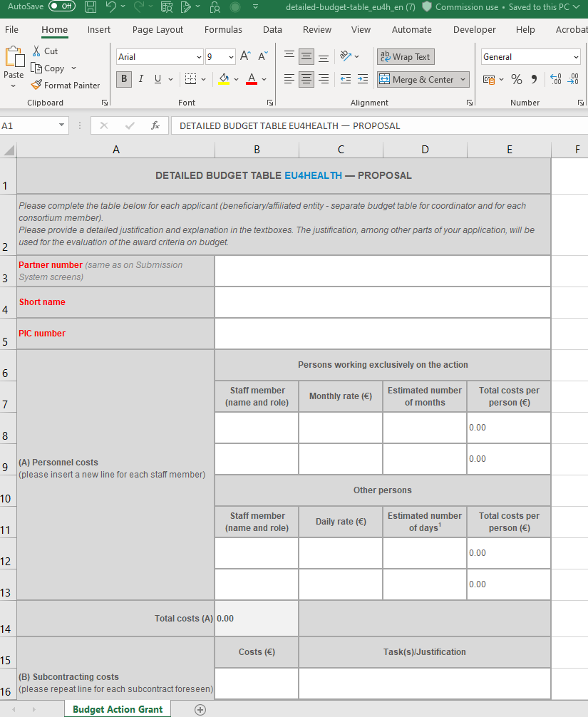
Detailed budget table (Tpl_Detailed_Budget_Table(EU4H).xlsx)
Notes:
Please complete the table below for each applicant (beneficiary/affiliated entity - separate budget table for coordinator and for each consortium member). Please provide a detailed justification and explanation in the textboxes. The justification, among other parts of your application, will be used for the evaluation of the award criteria on budget.

Slide 31
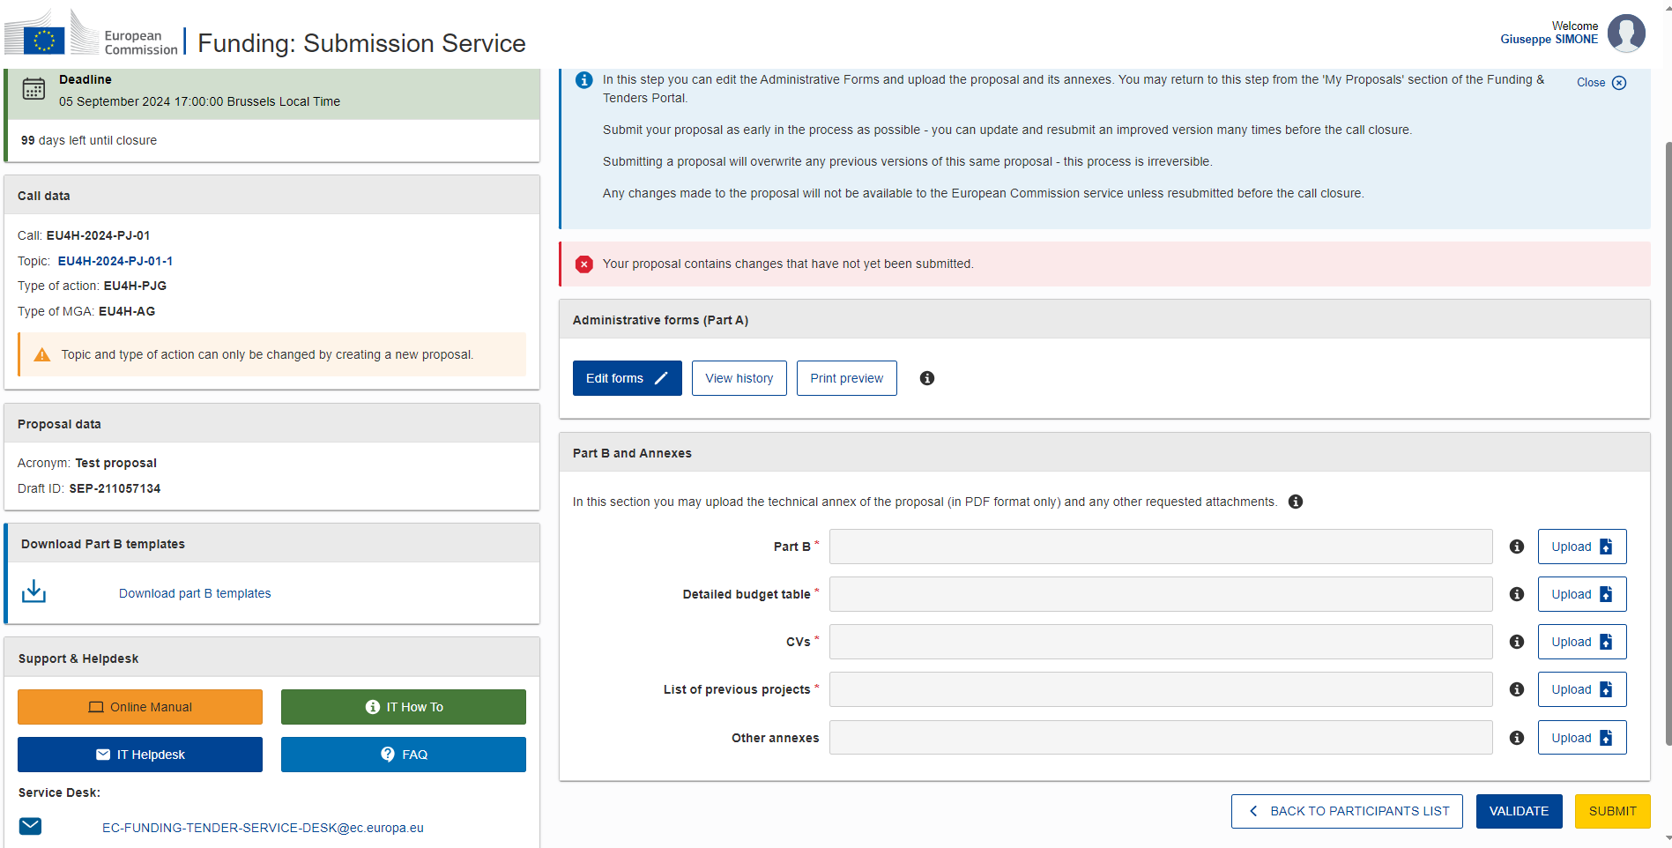

Slide 32
Evaluation

Slide 33
Standard evaluation process
Receipt of proposals
Individual evaluation
Consensus group
Evaluation committee
Finalisation
Admissibility/eligibility check
Allocation of proposals to external evaluators
Experts assess proposals individually.
Minimum of three experts per proposal
All individual experts discuss together to agree on a common position, including comments and scores for each proposal.
The evaluation committee reaches an agreement on the scores and comments for all proposals within a call, checking consistency across the evaluations.
Ranks the proposals with the same score.
The Commission/Agency puts together the final ranking list.

Slide 34
Award Criteria (I)
Relevance: clarity and consistency of project, objectives and planning; extent to which they match the themes and priorities and objectives of the call; contribution to the EU strategic and legislative context; European/trans-national dimension; impact/interest for a number of countries (EU or eligible non-EU countries); possibility to use the results in other countries; potential to develop mutual trust/cross-border cooperation (30 points)
Quality:
Project design and implementation: technical quality; logical links between the identified problems, needs and solutions proposed (logical frame concept); methodology for implementing the project (concept and methodology, management, procedures, timetable, risks and risk management, monitoring and evaluation); feasibility of the project within the proposed time frame; cost effectiveness (sufficient/appropriate budget for proper implementation; best value for money) (30 points)
Project team and cooperation arrangements: quality of the consortium and project teams; appropriate procedures and problem-solving mechanisms for cooperating within the project teams and consortium (30 points)

Slide 35
Award Criteria (II)
Impact: ambition and expected long-term impact of results on target groups/general public; appropriate dissemination strategy for ensuring sustainability and long-term impact; sustainability of results after EU funding ends (10 points).
Award criteria | Min pass score | Max score
Relevance | 21 | 30
Quality — Project design and implementation | 21 | 30
Quality — Project team and cooperation arrangements | 21 | 30
Impact | 7 | 10
Overall (pass) scores | 70 | 100

Slide 36
Grant Agreement Preparation

Slide 37
Grant Agreement Preparation (GAP) (I)
The Grant Agreement must be prepared directly in the Portal Grant Management System (paperless).
Where? Access to the Grant Management System is available through My Projects > Actions > Manage Project > Proposal Management & Grant Preparation > Grant agreement data preparation.
Who? The Grant Agreement data should be prepared by the consortium participants together and submitted by the Coordinator.
How? You will be prompted by e-mail for all the actions that you need to carry out for the grant preparation.

Slide 38
Grant Agreement Preparation (GAP) (II)
What? The grant preparation process consists of setting up the Portal Grant Management System with the:
participants' legal, administrative and financial information
description of the action (DoA, Annex 1 GA)
estimated budget (Annex 2 and 2a GA)
project variables (when the project starts, reporting periods, amount of prefinancing, GA options, etc.)
legal documents needed for grant signature (declarations of honour)
so that the system can generate the Grant Agreement and trigger signature directly inside the system (Grant Agreement and Accession Forms).

Slide 39
Grant Agreement Preparation (GAP) (III)
In parallel, the Granting Authority will perform the remaining legal checks to ensure that all the successful proposals can receive EU funding (legal entity validation, financial capacity check, non-exclusion check, etc.)
If your proposal is successful, you will be contacted for the validation of your PIC registration data.
It will be done by the Central Validation Service which carries out the validation for all EU services using the Portal.
The Central Validation Service will contact the person who registered the organisation (Self-registrant) and ask them to:
upload official supporting documents (via the My Organisations page)
clarify any details.

Slide 40
Description of the Action (DoA) (Part A and B)
The description of the action (DoA, Annex 1) is structured like the application form into two parts, Parts A and B:
Part A: contains the structured tables with project information (retrieved from the Grant Management System tabs)
Part B (the narrative part): is based on Part B of the application form and must be uploaded as a PDF.
The system will merge the Parts A and B, generating a single PDF with the full description of the action (DoA).
All participants can contribute to the parts, but it is the Coordinator who will have to finalise and submit it.

Slide 41
Tasks of the Coordinator
Complete the workplan tables in Part A, (work package descriptions, deliverables and milestones)
Check that all PICs have been validated by the Central Validation Service
Quality check:
Check that the DoA is coherent and that information in Part A and B is consistent.
Check that DoA and the application match. In addition, you may correct shortcomings identified by the experts in the evaluation summary report. The information presented in the DoA can be made more consistent if necessary. Any errors should be corrected (data displayed in a table or figure is at odds with the description, etc.)
Check that the DoA and the legal and administrative information match: for example, it must describe the role and tasks performed by each Partner defined in the structured part.
Make sure that the template has been followed and all sections are completed and no annexes are missing.

Slide 42
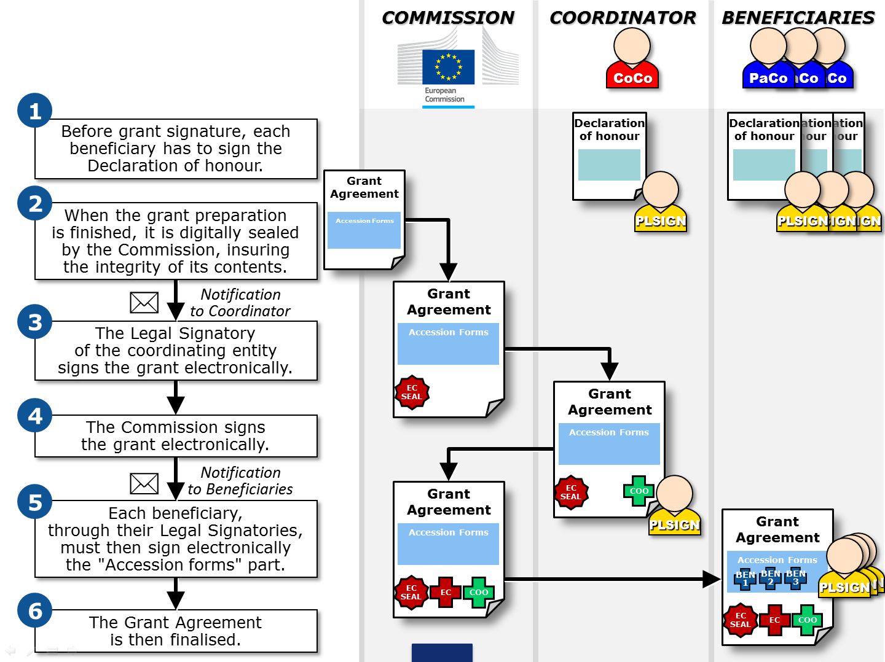

Slide 43
STEP
Strategic Technologies for Europe Platform

Slide 44
STEP
To support European Industry and boost investment in critical technologies in Europe.
STEP will raise and steer funding across 11 EU programmes to three target investment areas:
Digital technologies and deep-tech innovation
Clean and resource efficient technologies
Biotechnologies
STEP also supports projects growing skills necessary to the development of those critical technologies. STEP introduces a new STEP Seal – an EU label for high quality projects – granting STEP projects visibility and facilitating their access to other possible sources of funding.

Slide 45
How does it work? (I)
The STEP Seal will be awarded by the European Commission to projects meeting the minimum quality requirements (including eligibility, exclusion, and award criteria) in the selection process of a competitive procedure of calls for proposal.
To get awarded the STEP Seal, projects must contribute to at least one the STEP objectives:
support the development or manufacturing of critical technologies throughout the Union, or safeguarding and strengthening the respective value chains in the following sectors:
digital technologies and deep tech innovation,
clean and resource efficient technologies, including net-zero technologies,
biotechnologies.
address shortages of labour and skills critical to all kinds of quality jobs in those sectors.

Slide 46
How does it work? (II)

Slide 47
STEP seal
The STEP Seal (so called “Sovereignty Seal” under the STEP Regulation) is the EU quality label awarded to the high-quality projects contributing to the STEP objectives.
It will give them visibility and help attract alternative or additional public and private investments.
There is no additional specific procedure to apply for the STEP Seal.

Slide 48
Who can benefit and why is it helpful?
Any organisation or consortium which has applied for funding under the EU4Health programme, provided that the project contributes to the STEP objectives and that it has been assessed as eligible and complying with the minimum quality requirements defined in a call for proposals.
The STEP Seal will enhance access to EU funding, notably by facilitating alternative cumulative or combined funding from several EU budget instruments. For instance, Member States can grant support from Cohesion policy funds to projects having been awarded a STEP Seal directly, without any additional selection procedures.
More info available at Strategic Technologies for Europe Platform

Slide 49
Thank you
© European Union 2023
Unless otherwise noted the reuse of this presentation is authorised under the CC BY 4.0 license. For any use or reproduction of elements that are not owned by the EU, permission may need to be sought directly from the respective right holders.
Slide xx: element concerned, source: e.g. Fotolia.com; Slide xx: element concerned, source: e.g. iStock.com
Notes:
Update/add/delete parts of the copy right notice where appropriate.
More information: https://myintracomm.ec.europa.eu/corp/intellectual-property/Documents/2019_Reuse-guidelines%28CC-BY%29.pdf

