Slide 1
Better Training for Safer Food Initiative
BTSF
Reports and Payments
BTSF INFO DAY 2019
Chafea
Luxembourg, 11 September 2019

Slide 2
CONTENTS
REPORTS
Timeline for reporting
How to submit a report
CIRCABC
Contents of reports
PAYMENTS
Documents
Contingency payment

Slide 3
Timeline for reporting
30 working days | Kick-off meeting
60 working days | First interim report and draft presentations
M 4-5 | Start of the trainings
M 12 | Second interim report with pedagogical review
M 18 | Third interim report
M 23 | Assessment meeting (if applicable). Draft final report and draft final syllabus
M 24 | Final report with final syllabus, evaluation of trainings and training material

Slide 4
How to submit a report
Step 1: Upload draft report to CIRCABC, inform Chafea by e-mail
Step 2: Revise the report according to Chafea's comments, upload revised version to CIRCABC. Inform Chafea by e-mail
Step 3: After technical acceptance, upload final version (Word+PDF), and send payment request to Chafea

Slide 5
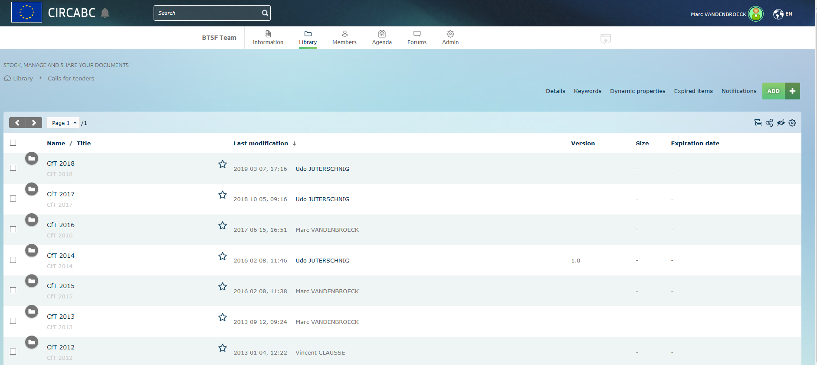
CIRCABC Communication and Information Resource Centre for Administrations, Businesses and Citizens
- Clear title: contract number, type of report, status, version number, date
- Compile information in one file if possible
- Max 100 MB

Slide 6
Clear identification for each report
On cover page and header/footer:
- Contract number, title, date, status, version
- Numbered chapters and pages
- List of contents and annexes

Slide 7
Some general content elements
- Overview on training sessions, number of participants trained, participating countries, evaluation results, etc.
- Overview of the tutors and project management team
- Deviations related to participants, tutors, project team, etc., shall be reported well before the session by e-mail and afterwards included in the reports
- BTSF Database filled in before report

Slide 8
Payment scheme
- No pre-financing payment
- 1st interim payment upon technical acceptance of 1st interim report: 20 %
- 2nd interim payment upon technical acceptance of 2nd interim report: 20 %
- 3rd interim payment technical acceptance of 3rd interim report: 20 %
- Balance payment upon technical acceptance final report: 40 %

Slide 9
Interim payments
1. Interim report technically accepted
2. When accepted upload final version and send payment request to Chafea
3. Include statement of trained participants :
2nd IP: more than 40 % of participants
3rd IP: more than 70 % of participants

Slide 10
Balance payment
1. Final report technically accepted, all PowerPoint presentations and other training material on CIRCABC
2. Send payment request to Chafea
3. Include statement of trained participants and audit certificate
Payment in full if more than 95 % of the requested number of participants were successfully trained

Slide 11
Use of Contingency
Before the activity:
1. Request from Chafea
2. Technical and financial offer
3. Approval from Chafea
After the activity:
4. Submission of additional report
5. Acceptance from Chafea
6. Sending request for contingency payment

Slide 12
Contingency payment
Only payments in line with the approval letter from Chafea can be done

Slide 13
Please pay attention:
- Send reports in time and payment request as soon as the report is accepted (also contingency!)
- Bank account as in the contract

Slide 14
THANK YOU
FOR YOUR ATTENTION
European Commission Consumers, Health, Agriculture and Food Executive Agency L-2920 Luxembourg

