Slide 1
Call for Proposals ON next-gen respiratory protection, CP-g-24-11, EU4H-2024-PJ-01-2
Andreas Prenner
Policy Officer, HERA.02
Andreas.prenner@ec.europa.eu

Slide 2
Presentation Outline
Call overview & policy context
Innovation targeted – overview of implementation options
Mandatory deliverables, indicators and expected results

Slide 3
Call for proposals: next-gen respiratory PPE
Call for detailed proposals, incl. timeline and cost overview, of:
Development
Certification
Uptake: healthcare settings, critical workers, stockpiling
…of next-generation respiratory protection
Budget: €20 million (expectation of 4 grants)
60-80% cost reimbursement
Open to applicants from EU and associated third countries

Slide 4
covid-19 showed ppe drawbacks
Respiratory protection critical in saving lives in health emergencies
Particularly in early pandemic phase, before vaccines developed
Significant drawbacks of respiratory protection used in Covid-19 (surgical, FFP2 masks)
Initial shortages
Protection against highly transmissible pathogens
Fit-testing
No comfortable multi-hour use
Notes:
Mention PPE is ready before MCMs
You can solve this! Call to action

Slide 5
Innovation targets
Reusability
Environmental impact
Risk of supply chain disruptions
Affordability
Comfortable multi-hour use
Highly protective
‘Universal’ fit
Optimised for stockpiling
Minimum space requirements
Long shelf life
Notes:
powered filtering devices
Cost should allow switch
No need to fulfil all aspects
Critical that grantees also ensure availability

Slide 6
Option 1: Elastomeric half-masks
Stress-test for 100 cycles of hospital-grade hygienic reprocessing
Filter lifecycle of at least 100 8h-shifts
Either of the following:
Scalable production with supply chains in Europe
Optimised for long-term storage (shelf life, space requirements)

Slide 7
Option 2: powered filtering device (‘PAPR’)
Unit price < EUR 200 (at scale production)
Low lifecycle cost (e.g. reusable and durable hoods, filters and components)
Desirable attributes:
Low communication barriers (e.g., by reducing fan noise)
Source control
Easy disinfection and reprocessing
Compatible with UV-disinfection
Increased comfort
Compatibility with standard rechargeable batteries
Scalable production in EU OR optimised for stockpiling
Notes:
Disinfection protocol with standard hospital equipment
(e.g., by reducing weight and preventing heat buildup)

Slide 8
Option 3: Other innovation
Enhanced communication
Improved aesthetic appeal
Better breathability or thermal comfort (e.g. advanced materials)
Sensors for real-time fit assurance or leakage detection
Low risk of self-contamination during doffing
Universal fit (95% of adult population) without fit-testing
Maintain fit and user compliance during extended periods of use
Long shelf lives (12 years or more)
Notes:
Fit assurance/leakage detection: e.g. using dual-channel condensation particle counters

Slide 9
Ensuring Uptake
Proposals need to detail plan for market and uptake in preparedness times:
Active use to protect healthcare and other critical workers
Stockpiling
Significant percentage of budget funds testing and distribution of product
Consortia may include hospital management, stockpiling organisations, critical workers
Option to establish user-managed inventory (supply bubbles close to end users)
Plan to generate sufficient demand to set up production
Notes:
Availability in emergencies

Slide 10
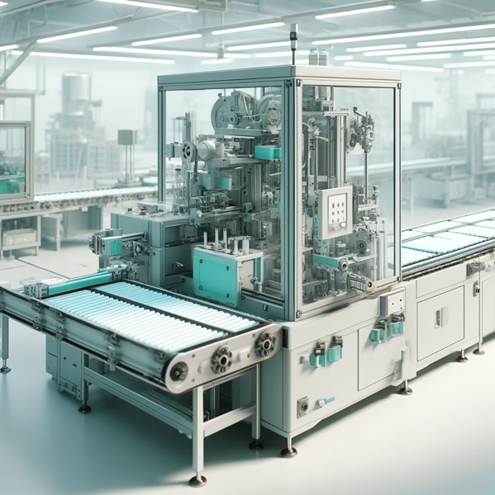
Option 4: Manufacturing innovation
Innovative manufacturing processes for rapid scale-up in emergencies
Novel automation technology to minimise need for human labour
Best practices for stockpiling raw materials
Distributed manufacturing solutions
Availability in emergencies ensured through rapid scale-up
No focus on distribution in preparedness times
Notes:
For innovative manufacturing processes:
- novel automation technology to minimise need for human labour
- best practices for stockpiling raw materials
Fit assurance/leakage detection: e.g. using dual-channel condensation particle counters

Slide 11
Mandatory Deliverables set expectations
Development activities, studies and tests
Consultations with user base (essential workers in- and outside of healthcare)
Detailed analysis of costs (material, personnel, manufacturing, etc.) and resale price
Testing and trial results
Engagement with notified bodies and regulatory authorities
Notes:
Last bullet: defining the pathway to conformity assessment and submission of applications

Slide 12
Indicators Measuring success
Resale price and lifetime cost of devices
Projected shelf life
Number of distributed units (projection in offer)
For manufacturing innovation: potential for rapid scaleup within first months of emergency
Number of consultations with user base (essential workers in- and outside of healthcare)
Number of individuals evaluated for fit
Quantitative user satisfaction levels

Slide 13
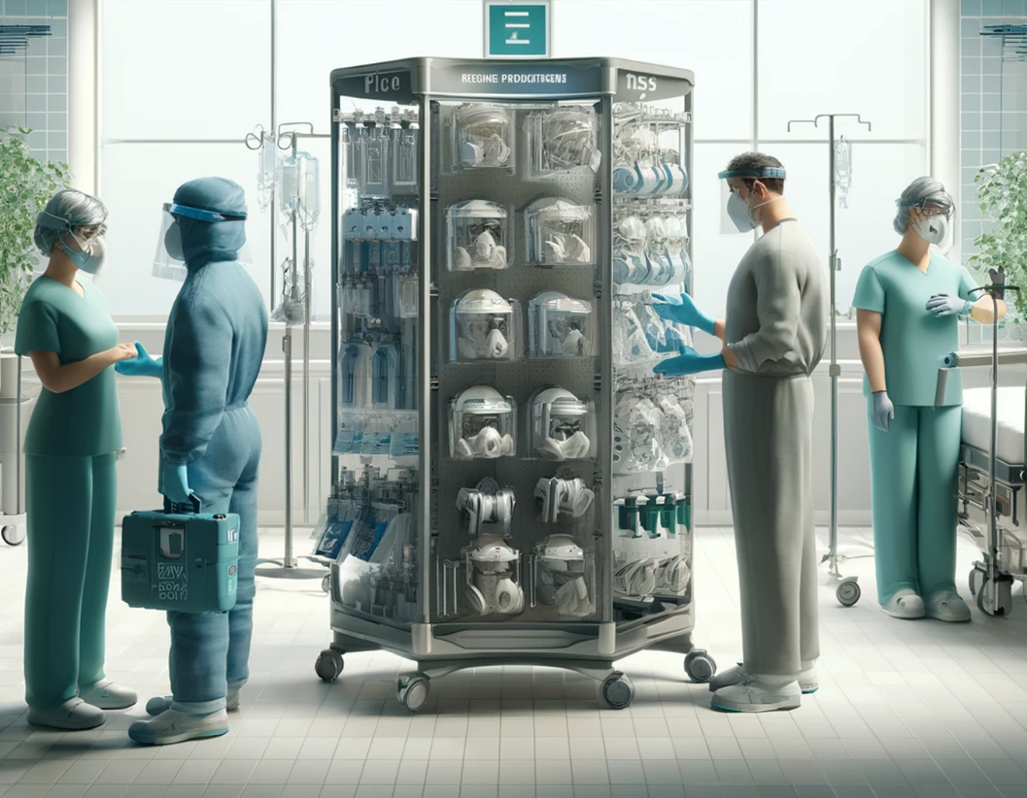
Your proposals Enable better preparedness
More choice for personal protection:
Healthcare workers
Other essential workers
General public
Next-gen respiratory protection slowly replaces existing devices
Wide Incorporation into clinical practice

Slide 14
Thank you!
Andreas Prenner
Policy Officer, HERA.02
Andreas.prenner@ec.europa.eu

