Slide 1
EU4Health - 2024 Work Programme Joint Action Support to the development of sustainable, forward-looking national and Union stockpiling strategies
FINANCIAL MANAGEMENT

Slide 2
Definition: Grant is direct financial contribution to an action
(Financial Regulation, 2018/1046. Title VIII – Grants)
Co-funding rule: external co-financing from a source other than EC funds is required (own resources or financial contributions from third parties, project income)
Non-profit rule: the grant may not have the purpose or effect of producing a profit for the beneficiary
Non-retroactivity rule: only costs incurred after the starting date stipulated in the grant agreement can be co-funded
Non-cumulative rule: only one grant can be awarded for a specific action carried out by a given beneficiary

Slide 3
Form of the grant – Data Sheet point 3, Article 5, Article 39 of the Grant Agreement
Action grant
Grant based on actual costs declared with unit costs and flat rate elements
Grant = partial reimbursement of eligible costs that are incurred by beneficiaries and affiliated entities listed in the grant agreement at the fixed reimbursement rate.
Reimbursement rate: 60% of eligible costs
Exceptional utility: 80% of eligible costs
“Maximum grant amount” the maximum amount the Agency will be able to pay as contribution to the action’s costs.
Budget flexibility: budget maybe adjusted, without formal amendment, as long as it does not imply any substantive or important change to the description of the action

Slide 4
Eligible costs – Data Sheet point 3, Article 6 of the Grant Agreement
General conditions - Cumulative requirements:
Connected with the action as described in Annex 1 and included in the Estimated Budget (Annex 2);
Necessary for the implementation of the action;
Reasonable and justified - “good housekeeping”;
Incurred within the duration;
Actually incurred by the beneficiaries / affiliated entities of the grant;
Identifiable and verifiable, in particular being recorded in the accounting records of beneficiary / affiliated entity in accordance with accounting standards and the beneficiary’ accounting practices.

Slide 5
Ineligible costs – Article 6 of the Grant Agreement
In-kind contributions from third parties;
VAT, when the beneficiary is able to deduct or recover it;
Reckless and excessive expenditures;
Costs declared under another grant;
Financial support to third parties

Slide 6
Budget categories – Article 6 of the Grant Agreement
Direct Costs
Direct personnel costs (employees + natural persons with direct contract + seconded persons)
Subcontracting (engagement of a 3rd party to carry out certain activities of the proposed action)
Purchase costs
Travel, accommodation and subsistence allowances (unit cost)
Equipment (depreciation, renting, leasing)
Other goods and services
Indirect Costs
E. Flat rate of 7% of total direct costs

Slide 7
Personnel costs
Cost of employees
Costs claimed: salary + social security + taxes;
Any other costs included in the remuneration (= statutory charges) based on national law or employment contracts;
Supplementary payments
Cost for natural persons with a direct contract and seconded persons against payment
Similar conditions as employment: at the beneficiary's premises, results belong to the beneficiary with similar costs of employment

Slide 8
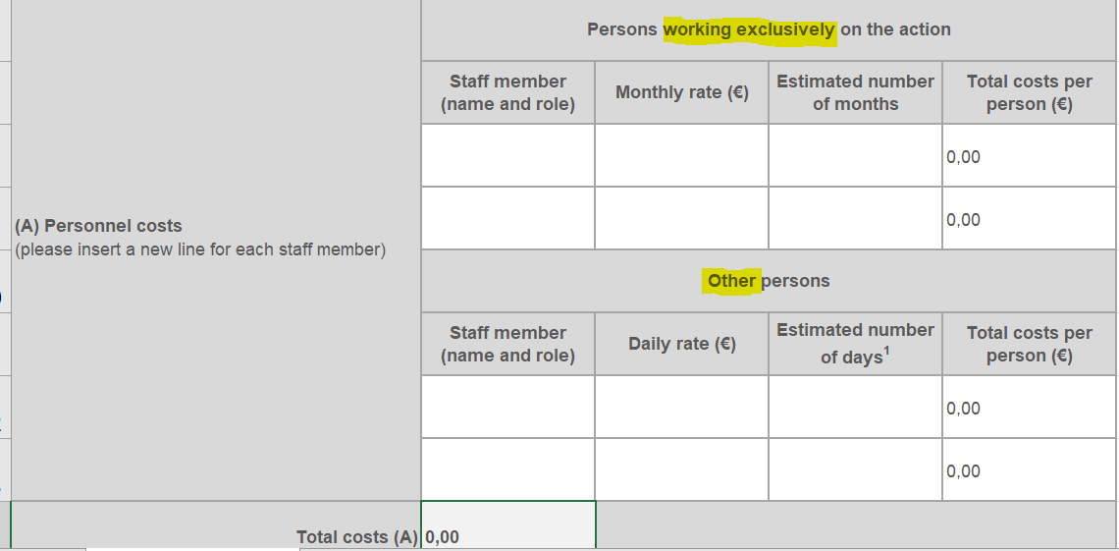
Personnel costs – budget template

Slide 9
Personnel costs – recommendations
Consistent data with Annex 1 - Description of the action - for staff efforts.
Annex 1: total person-month per work package
Detailed budget: number of estimated days. Please use 18 days working days per month to calculate the person-months
Persons working exclusively for the action: contracts specifically refer to the grant, no other tasks
Other persons
Describe the function, work package and the task of the person
Describe contract type (employment, natural person with direct contract, secondment)

Slide 10
Subcontracting – Article 7 and 9 of the Grant Agreement
Contracts awarded to cover the execution of an action / task described in Annex 1 of the grant agreement.
Activities undertaken by the project and proposed for co-funding
Service contracts
Invoices (including taxes, charges)
Core elements and technical / financial management of the action cannot be subcontracted
Tasks subcontracted must be clearly set out in Annex 1;
Requirement of transparency, best value for money and, if appropriate, lowest price. Conflict of interest must be avoided;
Documents of procedures applied must be available.

Slide 11
Subcontracting
Third parties to describe in Annex 1 Part B
Amount of Subcontracting in Annex 1 Part B must be consistent with detailed budget
Justification for subcontracting when its proportion of total costs > 30%
Annex 1 Part B and the detailed budget should describe the activity or the task (!), not the subcontractor!

Slide 12
Travel and subsistence – Annex 2a of the Grant Agreement
Travel & subsistence incurred as costs by the beneficiary for all participants, except subcontractors shall be claimed here:
Personnel
Collaborating stakeholders
Invited experts, speakers
Board members
Trainees, other participants
Unit costs following the Commission Decision C(2021)35 and its amendment of C(2023)4928.

Slide 13
Travel and subsistence
Link to calculation tool is available in the Commission Decision
Describe your planned events: type of event, planned duration, planned number of participants
3 components: travel, subsistence, accommodation
Describe your calculation method – you may use the average unit costs of EU countries or the highest unit costs of EU countries
Example: 1-day Stakeholder meeting with approx. 10 participants calculated with the average of unit costs of EU countries

Slide 14
Equipment
Specific equipment necessary for the action
General rule: depreciation costs of the equipment.
Describe the equipment you plan to purchase
Describe the type of costs (depreciation, rent or leasing)

Slide 15
Other goods and services
Must be directly linked to and necessary to implement the action
Requirement of transparency, best value for money and, if appropriate, lowest price. Conflict of interest must be avoided.
Examples (non-exhaustive):
Dissemination of information;
Specific evaluation of the action;
Certificates of financial statements;
Translations, reproduction of reports;
Consumables and supplies (excluding general office supply);
Cost of financial guarantee, if applicable.

Slide 16
Other goods and services
Threshold for CFS (Certificate on financial statement): individual grant amount of 325.000 EUR – you can plan costs here
Describe your planned cost items

Slide 17
Cash flow – Data Sheet point 4, Article 21 and 22 of the Grant Agreement
Beneficiaries / affiliate entities carry out activities, generate costs – e.g. pay salaries, subcontracting, travel, purchases, etc.
Starting date
Interim report(s)
End date
50 % pre-financing payment at signature of the grant agreement
Assessment of technical reports,
deliverables and costs declared, reimbursement of eligible costs

Slide 18
Personal tips
Read the invitation documents, grant agreement / annotated grant agreement
HADEA Guidance documents: FAQ + presentation on unit costs
Involvement of Accounting, HR and Procurement of the partners
Accounting – all available financial information and supporting documents
HR department – who is staff, components of salary
Procurement / Sourcing – contract management with third parties, applicable procedures
Consortium agreement for multi-beneficiary grants (article 7 of the grant agreement): internal project management, internal deadlines, monitoring of expenditures, etc.

Slide 19
Thank you
© European Union 2020
Unless otherwise noted the reuse of this presentation is authorised under the CC BY 4.0 license. For any use or reproduction of elements that are not owned by the EU, permission may need to be sought directly from the respective right holders.
Slide xx: element concerned, source: e.g. Fotolia.com; Slide xx: element concerned, source: e.g. iStock.com
Notes:
Update/add/delete parts of the copy right notice where appropriate.
More information: https://myintracomm.ec.europa.eu/corp/intellectual-property/Documents/2019_Reuse-guidelines%28CC-BY%29.pdf

