Slide 1
Better Training for Safer Food Initiative
BTSF
eSubmission presentation
BTSF INFO DAY 2019
Chafea
Luxembourg, 11 September 2019

Slide 2
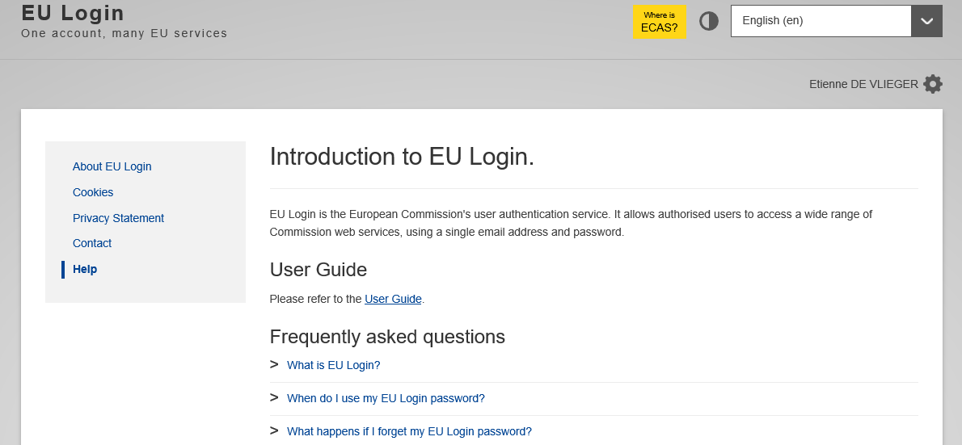
What I need to access eSubmission ?
- EU Login
Online manual:
https://webgate.ec.europa.eu/cas/help.html

Slide 3
What I need to access eSubmission ? (cont.)
- To be registered in the Commission's organisations register
- To have a Participant Identification Code (PIC)

Slide 4
What is eSubmission ?
eSubmission is a eProcurement step : it's a pre-award module
Pre-Award modules
TED

TED e-Tendering
eSubmission
(Back end & Front end)



Slide 5
What is eSubmission for ?
Tenders
Prepare & submit tenders electronically in a secure way
Contracting Authority
Receive tenders electronically & perform Opening session

Slide 6
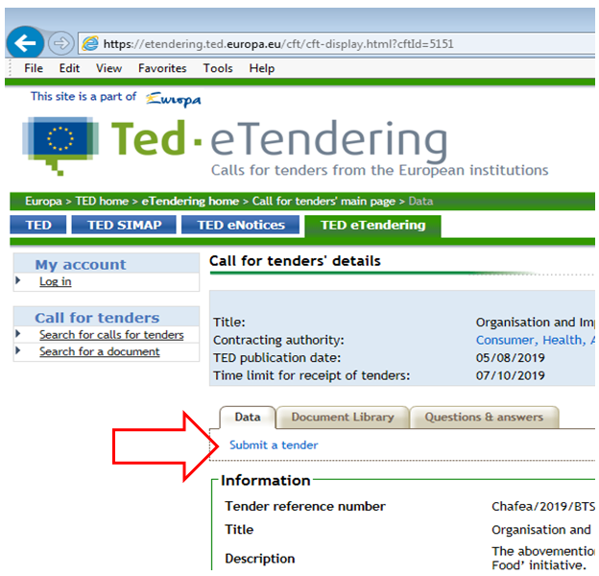
How to submit a tender in eSubmission ?
'Submit a tender' button
Available in TED-eTendering
When clicking on it, you are redirected to eSubmission

Slide 7
How to submit a tender in eSubmission ?
Create a tender
- Accept the terms and Conditions and read the Data Notice
- Click on 'New tender'

Slide 8
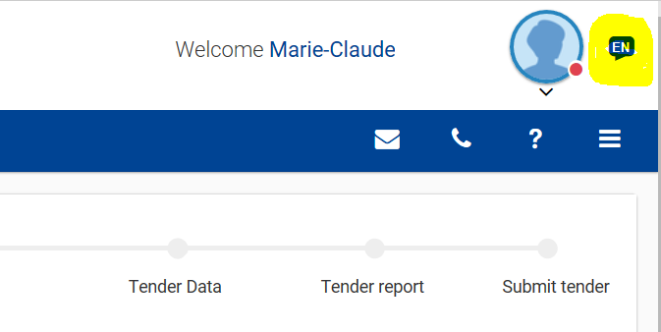
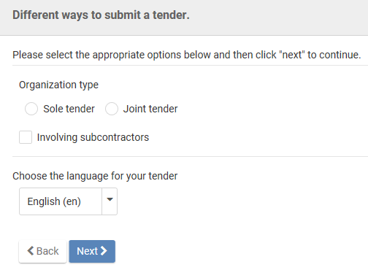
How to submit a tender in eSubmission ?
Ways to submit a Tender: Sole tender or Joint tender

Slide 9
How to submit a tender in eSubmission ?
Ways to submit a Tender: Sole tender or Joint tender
Sole tender
Joint tender

Slide 10
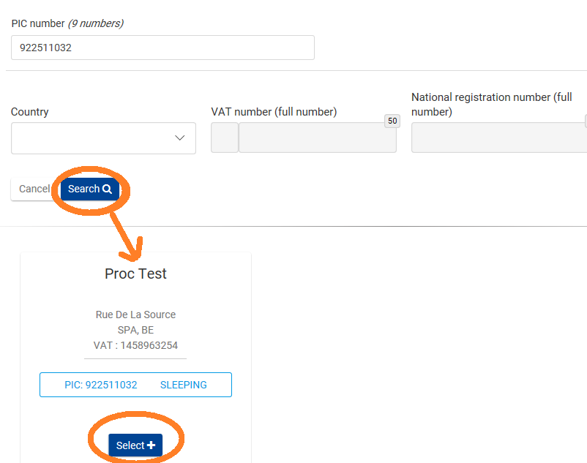
How to submit a tender in eSubmission ?
Search for the PIC of the group leader or main tenderer

Slide 11
How to submit a tender in eSubmission ?
Attachments to upload the 'Declaration of Honour', technical and financial documents required by the contracting authority
Once it's done, in case of 'Joint tender' or 'tender with subcontractors', click +New party
For subcontractors, the PIC is not required
Once that all the parties are added, click on to go to the next step

Slide 12
Attachment of documents
- Formats: Word, Excel, Power Point documents, pdf documents, most common image types, email attachments, plain texts, zip files
- Size: 50MB per attachment

Slide 13
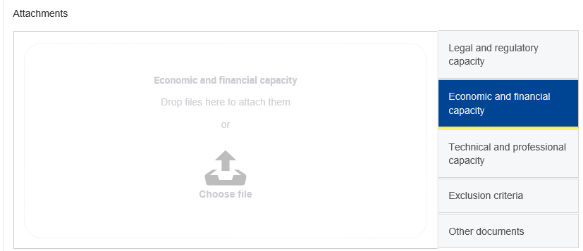
How to submit a tender in eSubmission ?
- Section to drag and drop your financial and technical documents
Once that every document is added, click on to fill in the amounts

Slide 14
How to submit a tender in eSubmission ?
- The fields to add the amounts are displayed
Then click on to save the indicated amounts
Once the tender is correct and completed, click on to finish

Slide 15
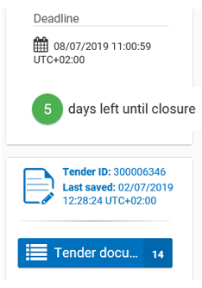
How to submit a tender in eSubmission ?
At this stage, your tender is in DRAFT and not yet submitted
Click on 'Next>' to generate the tender report

Slide 16
How to submit a tender in eSubmission ?
Tender Report
If your tender is complete and ready for submission
- Download the tender report
by clicking on
- Have it signed by the authorized representative or the Group leader in case of Joint Tender
- Hand-written signature
- Electronic signature

Slide 17
How to submit a tender in eSubmission ?
To upload the tender report
Always verify that the Report ID is the same as
the tender ID displayed
- Select your tender report signed and upload it
- Click on to proceed

Slide 18
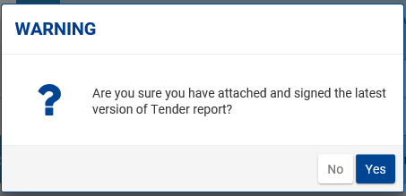
How to submit a tender in eSubmission ?
A warning pops up. Read it carefully
Click Yes to confirm.
This report is not a proof of submission because your tender is not yet submitted !

Slide 19
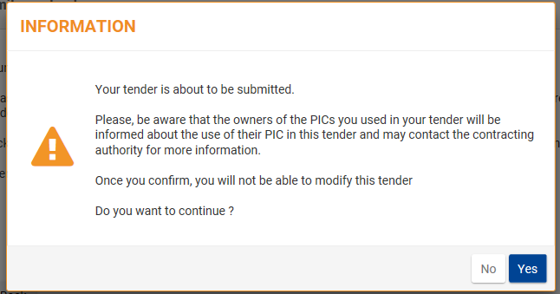
How to submit a tender in eSubmission ?
To submit the tender:
Click on the button
After this you will no longer be able to make any changes to this tender.
Click Yes to finalise the submission

Slide 20
How to submit a tender in eSubmission ?
After that the tender has been submitted
- Email notification is sent
- Window pops up

Slide 21
How to submit a tender in eSubmission ?
Click on the 'F&T portal' or 'Display your tenders '

Slide 22
Contact in case of problems
- Online help
https://webgate.ec.europa.eu/fpfis/wikis/display/ePRIOR/eSubmission%3A+respond+to+a+call+for+Tenders
- DIGIT-ESUBMISSION-SUPPORT@ec.europa.eu
Support:
- EU support group
- Centralized
- Permanent

Slide 23
ANY QUESTIONS?
THANK YOU!
European Commission Consumers, Health, Agriculture and Food Executive Agency L-2920 Luxembourg

